Slide 1
An Introduction to Parallel Programming
Peter Pacheco
Chapter 2
Parallel Hardware and Parallel Software

Slide 2
Roadmap
# Chapter Subtitle
Some background
Modifications to the von Neumann model
Parallel hardware
Parallel software
Input and output
Performance
Parallel program design
Writing and running parallel programs
Assumptions

Slide 3
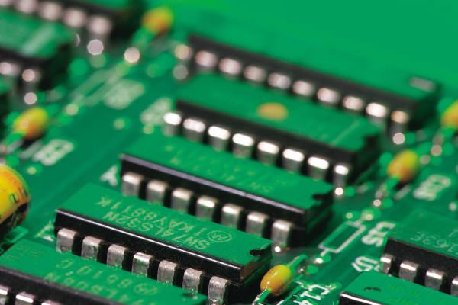


Some background

Slide 4


Serial hardware and software
programs
input
Computer runs one
program at a time.
output

Slide 5
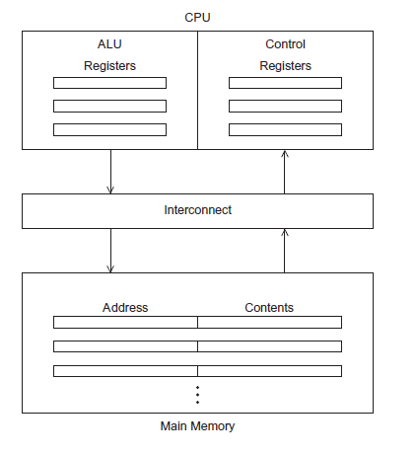
The von Neumann Architecture
# Chapter Subtitle
Figure 2.1

Slide 6
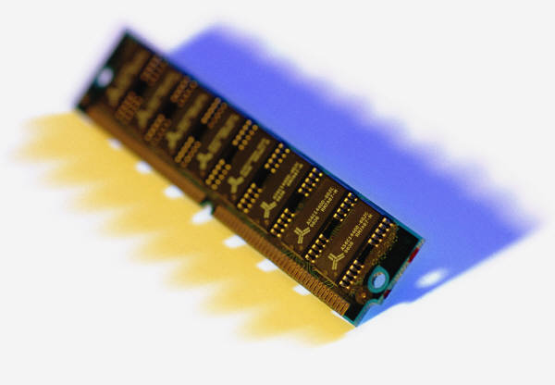
Main memory
This is a collection of locations, each of which is capable of storing both instructions and data.
Every location consists of an address, which is used to access the location, and the contents of the location.

Slide 7

Central processing unit (CPU)
Divided into two parts.
Control unit - responsible for deciding which instruction in a program should be executed. (the boss)
Arithmetic and logic unit (ALU) - responsible for executing the actual instructions. (the worker)
add 2+2

Slide 8
Key terms
Register – very fast storage, part of the CPU.
Program counter – stores address of the next instruction to be executed.
Bus – wires and hardware that connects the CPU and memory.

Slide 9
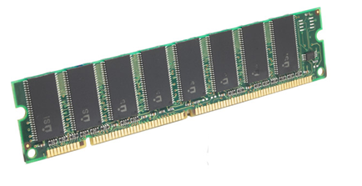

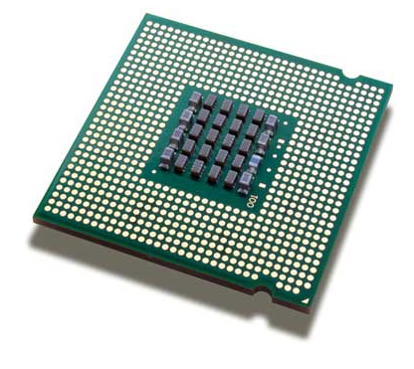
memory
fetch/read
CPU

Slide 10

memory
write/store
CPU

Slide 11


von Neumann bottleneck

Slide 12
An operating system “process”
An instance of a computer program that is being executed.
Components of a process:
The executable machine language program.
A block of memory.
Descriptors of resources the OS has allocated to the process.
Security information.
Information about the state of the process.

Slide 13
Multitasking
Gives the illusion that a single processor system is running multiple programs simultaneously.
Each process takes turns running. (time slice)
After its time is up, it waits until it has a turn again. (blocks)

Slide 14
Threading
Threads are contained within processes.
They allow programmers to divide their programs into (more or less) independent tasks.
The hope is that when one thread blocks because it is waiting on a resource, another will have work to do and can run.

Slide 15
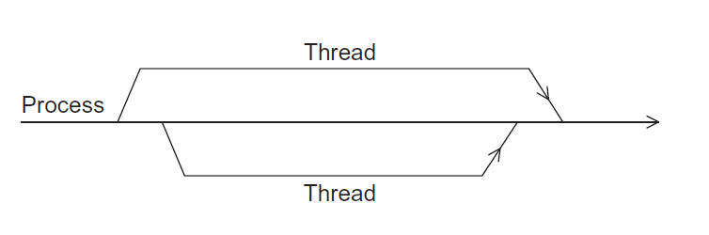
A process and two threads
the “master” thread
terminating a thread
Is called joining
starting a thread
Is called forking
Figure 2.2

Slide 16

Modifications to the von neumann model

Slide 17

Basics of caching
A collection of memory locations that can be accessed in less time than some other memory locations.
A CPU cache is typically located on the same chip, or one that can be accessed much faster than ordinary memory.

Slide 18
Principle of locality
Accessing one location is followed by an access of a nearby location.
Spatial locality – accessing a nearby location.
Temporal locality – accessing in the near future.

Slide 19
Principle of locality
float z[1000];
…
sum = 0.0;
for (i = 0; i < 1000; i++)
sum += z[i];

Slide 20
Levels of Cache
smallest & fastest
L1
L2
L3
largest & slowest

Slide 21
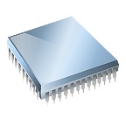
Cache hit
fetch x
L1
x sum
L2
y z total
L3
A[ ] radius r1 center

Slide 22
Cache miss
fetch x
x
main
memory
L1
y sum
L2
r1 z total
L3
A[ ] radius center

Slide 23
Issues with cache
When a CPU writes data to cache, the value in cache may be inconsistent with the value in main memory.
Write-through caches handle this by updating the data in main memory at the time it is written to cache.
Write-back caches mark data in the cache as dirty. When the cache line is replaced by a new cache line from memory, the dirty line is written to memory.

Slide 24
Cache mappings
Full associative – a new line can be placed at any location in the cache.
Direct mapped – each cache line has a unique location in the cache to which it will be assigned.
n-way set associative – each cache line can be place in one of n different locations in the cache.

Slide 25
n-way set associative
When more than one line in memory can be mapped to several different locations in cache we also need to be able to decide which line should be replaced or evicted.
x

Slide 26
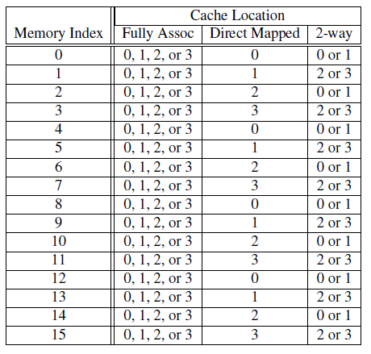
Example
Table 2.1: Assignments of a 16-line main memory to a 4-line cache

Slide 27
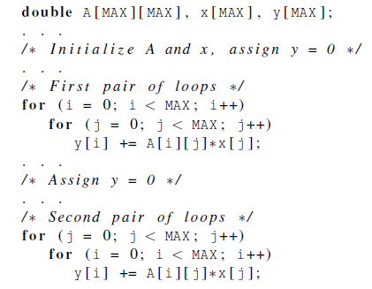
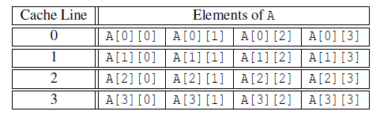
Caches and programs

Slide 28
Virtual memory (1)
If we run a very large program or a program that accesses very large data sets, all of the instructions and data may not fit into main memory.
Virtual memory functions as a cache for secondary storage.

Slide 29
Virtual memory (2)
It exploits the principle of spatial and temporal locality.
It only keeps the active parts of running programs in main memory.

Slide 30
Virtual memory (3)
Swap space - those parts that are idle are kept in a block of secondary storage.
Pages – blocks of data and instructions.
Usually these are relatively large.
Most systems have a fixed page size that currently ranges from 4 to 16 kilobytes.

Slide 31
Virtual memory (4)
program A
main memory
program B
program C

Slide 32
Virtual page numbers
When a program is compiled its pages are assigned virtual page numbers.
When the program is run, a table is created that maps the virtual page numbers to physical addresses.
A page table is used to translate the virtual address into a physical address.

Slide 33
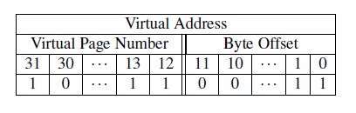
Page table
Table 2.2: Virtual Address Divided into Virtual Page Number and Byte Offset

Slide 34
Translation-lookaside buffer (TLB)
Using a page table has the potential to significantly increase each program’s overall run-time.
A special address translation cache in the processor.

Slide 35
Translation-lookaside buffer (2)
It caches a small number of entries (typically 16–512) from the page table in very fast memory.
Page fault – attempting to access a valid physical address for a page in the page table but the page is only stored on disk.

Slide 36
Instruction Level Parallelism (ILP)
Attempts to improve processor performance by having multiple processor components or functional units simultaneously executing instructions.

Slide 37
Instruction Level Parallelism (2)
Pipelining - functional units are arranged in stages.
Multiple issue - multiple instructions can be simultaneously initiated.

Slide 38


Pipelining

Slide 39
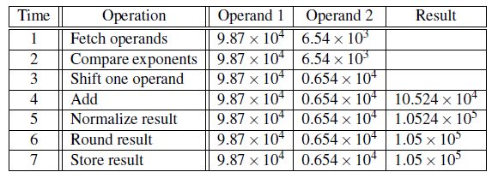
Pipelining example (1)
Add the floating point numbers 9.87×10⁴ and 6.54×10³

Slide 40

Pipelining example (2)
Assume each operation takes one nanosecond (10⁻⁹ seconds).
This for loop takes about 7000 nanoseconds.

Slide 41
Pipelining (3)
Divide the floating point adder into 7 separate pieces of hardware or functional units.
First unit fetches two operands, second unit compares exponents, etc.
Output of one functional unit is input to the next.

Slide 42
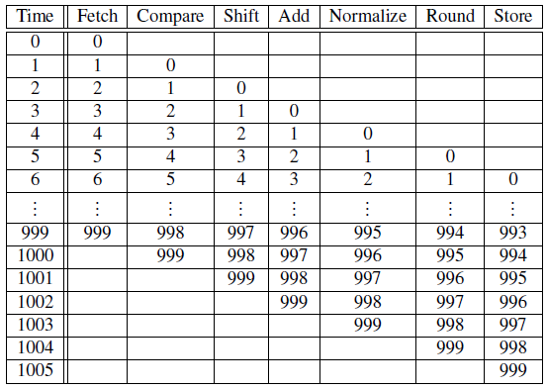
Pipelining (4)
Table 2.3: Pipelined Addition.
Numbers in the table are subscripts of operands/results.

Slide 43
Pipelining (5)
One floating point addition still takes 7 nanoseconds.
But 1000 floating point additions now takes 1006 nanoseconds!

Slide 44
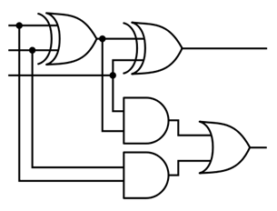
Multiple Issue (1)
Multiple issue processors replicate functional units and try to simultaneously execute different instructions in a program.
for (i = 0; i < 1000; i++)
z[i] = x[i] + y[i];
z[3]
z[4]
z[1]
z[2]
adder #1
adder #2

Slide 45
Multiple Issue (2)
static multiple issue - functional units are scheduled at compile time.
dynamic multiple issue – functional units are scheduled at run-time.
superscalar

Slide 46
Speculation (1)
In order to make use of multiple issue, the system must find instructions that can be executed simultaneously.
In speculation, the compiler or the processor makes a guess about an instruction, and then executes the instruction on the basis of the guess.

Slide 47
Speculation (2)
z = x + y ;
i f ( z > 0)
w = x ;
e l s e
w = y ;
Z will be
positive
If the system speculates incorrectly,
it must go back and recalculate w = y.

Slide 48
Hardware multithreading (1)
There aren’t always good opportunities for simultaneous execution of different threads.
Hardware multithreading provides a means for systems to continue doing useful work when the task being currently executed has stalled.
Ex., the current task has to wait for data to be loaded from memory.

Slide 49
Hardware multithreading (2)
Fine-grained - the processor switches between threads after each instruction, skipping threads that are stalled.
Pros: potential to avoid wasted machine time due to stalls.
Cons: a thread that’s ready to execute a long sequence of instructions may have to wait to execute every instruction.

Slide 50
Hardware multithreading (3)
Coarse-grained - only switches threads that are stalled waiting for a time-consuming operation to complete.
Pros: switching threads doesn’t need to be nearly instantaneous.
Cons: the processor can be idled on shorter stalls, and thread switching will also cause delays.

Slide 51
Hardware multithreading (3)
Simultaneous multithreading (SMT) - a variation on fine-grained multithreading.
Allows multiple threads to make use of the multiple functional units.

Slide 52
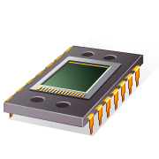
Parallel hardware
A programmer can write code to exploit.

Slide 53
Flynn’s Taxonomy
classic von Neumann
SISD
Single instruction stream
Single data stream
(SIMD)
Single instruction stream
Multiple data stream
MISD
Multiple instruction stream
Single data stream
(MIMD)
Multiple instruction stream
Multiple data stream
not covered

Slide 54
SIMD
Parallelism achieved by dividing data among the processors.
Applies the same instruction to multiple data items.
Called data parallelism.

Slide 55
SIMD example
n data items
n ALUs
control unit
…
x[1]
x[2]
x[n]
ALU₁
ALU₂
ALU_{n}
for (i = 0; i < n; i++)
x[i] += y[i];

Slide 56
SIMD
What if we don’t have as many ALUs as data items?
Divide the work and process iteratively.
Ex. m = 4 ALUs and n = 15 data items.
Round3 | ALU₁ | ALU₂ | ALU₃ | ALU₄
1 | X[0] | X[1] | X[2] | X[3]
2 | X[4] | X[5] | X[6] | X[7]
3 | X[8] | X[9] | X[10] | X[11]
4 | X[12] | X[13] | X[14]

Slide 57
SIMD drawbacks
All ALUs are required to execute the same instruction, or remain idle.
In classic design, they must also operate synchronously.
The ALUs have no instruction storage.
Efficient for large data parallel problems, but not other types of more complex parallel problems.

Slide 58
Vector processors (1)
Operate on arrays or vectors of data while conventional CPU’s operate on individual data elements or scalars.
Vector registers.
Capable of storing a vector of operands and operating simultaneously on their contents.

Slide 59
Vector processors (2)
Vectorized and pipelined functional units.
The same operation is applied to each element in the vector (or pairs of elements).
Vector instructions.
Operate on vectors rather than scalars.

Slide 60
Vector processors (3)
Interleaved memory.
Multiple “banks” of memory, which can be accessed more or less independently.
Distribute elements of a vector across multiple banks, so reduce or eliminate delay in loading/storing successive elements.
Strided memory access and hardware scatter/gather.
The program accesses elements of a vector located at fixed intervals.

Slide 61
Vector processors - Pros
Fast.
Easy to use.
Vectorizing compilers are good at identifying code to exploit.
Compilers also can provide information about code that cannot be vectorized.
Helps the programmer re-evaluate code.
High memory bandwidth.
Uses every item in a cache line.

Slide 62
Vector processors - Cons
They don’t handle irregular data structures as well as other parallel architectures.
A very finite limit to their ability to handle ever larger problems. (scalability)

Slide 63
Graphics Processing Units (GPU)
Real time graphics application programming interfaces or API’s use points, lines, and triangles to internally represent the surface of an object.

Slide 64

GPUs
A graphics processing pipeline converts the internal representation into an array of pixels that can be sent to a computer screen.
Several stages of this pipeline (called shader functions) are programmable.
Typically just a few lines of C code.

Slide 65
GPUs
Shader functions are also implicitly parallel, since they can be applied to multiple elements in the graphics stream.
GPU’s can often optimize performance by using SIMD parallelism.
The current generation of GPU’s use SIMD parallelism.
Although they are not pure SIMD systems.

Slide 66
MIMD
Supports multiple simultaneous instruction streams operating on multiple data streams.
Typically consist of a collection of fully independent processing units or cores, each of which has its own control unit and its own ALU.

Slide 67
Shared Memory System (1)
A collection of autonomous processors is connected to a memory system via an interconnection network.
Each processor can access each memory location.
The processors usually communicate implicitly by accessing shared data structures.

Slide 68
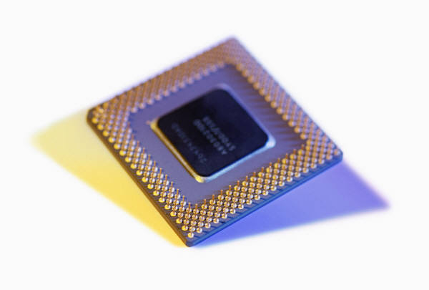
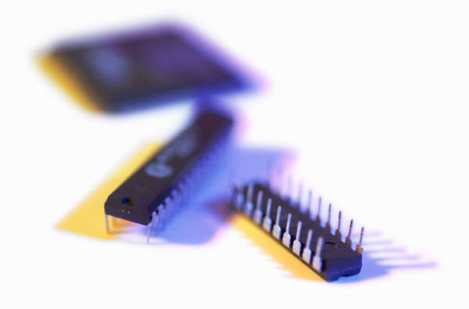
Shared Memory System (2)
Most widely available shared memory systems use one or more multicore processors.
(multiple CPU’s or cores on a single chip)

Slide 69
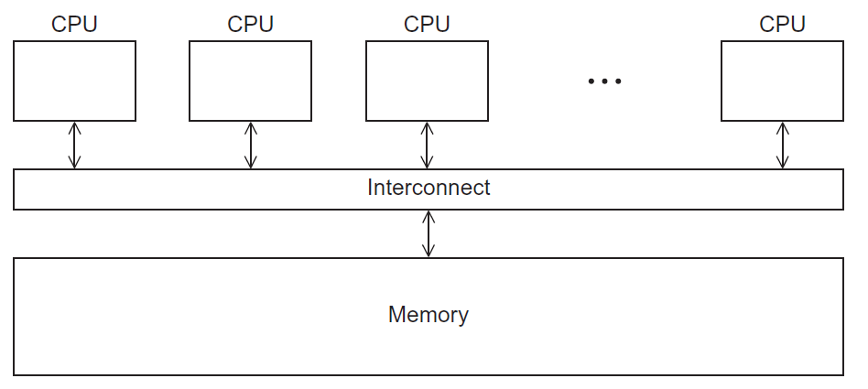
Shared Memory System
Figure 2.3

Slide 70
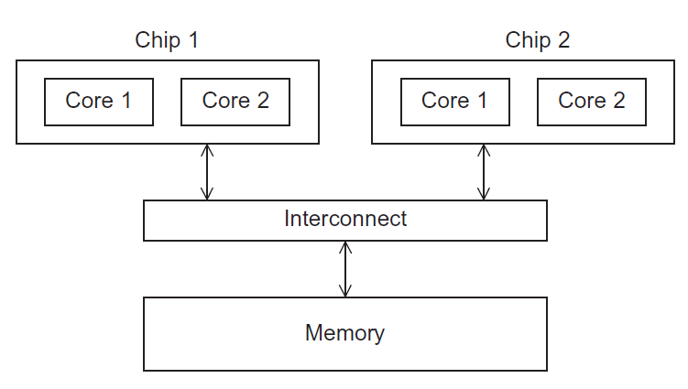
UMA multicore system
Time to access all
the memory locations
will be the same for
all the cores.
Figure 2.5

Slide 71
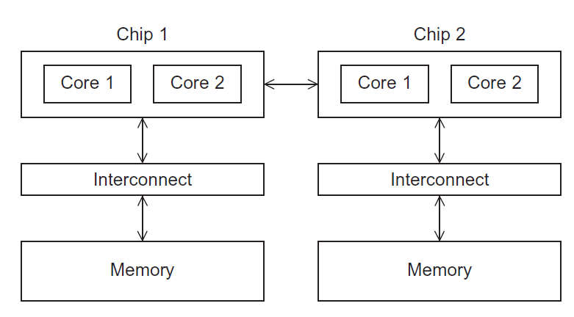
NUMA multicore system
A memory location a core is directly connected to can be accessed faster than a memory location that must be accessed through another chip.
Figure 2.6

Slide 72
Distributed Memory System
Clusters (most popular)
A collection of commodity systems.
Connected by a commodity interconnection network.
Nodes of a cluster are individual computations units joined by a communication network.
a.k.a. hybrid systems

Slide 73
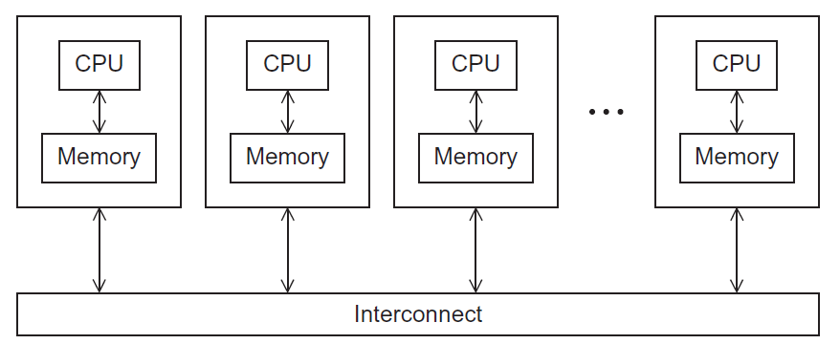
Distributed Memory System
Figure 2.4

Slide 74
Interconnection networks
Affects performance of both distributed and shared memory systems.
Two categories:
Shared memory interconnects
Distributed memory interconnects

Slide 75
Shared memory interconnects
Bus interconnect
A collection of parallel communication wires together with some hardware that controls access to the bus.
Communication wires are shared by the devices that are connected to it.
As the number of devices connected to the bus increases, contention for use of the bus increases, and performance decreases.

Slide 76
Shared memory interconnects
Switched interconnect
Uses switches to control the routing of data among the connected devices.
Crossbar –
Allows simultaneous communication among different devices.
Faster than buses.
But the cost of the switches and links is relatively high.

Slide 77
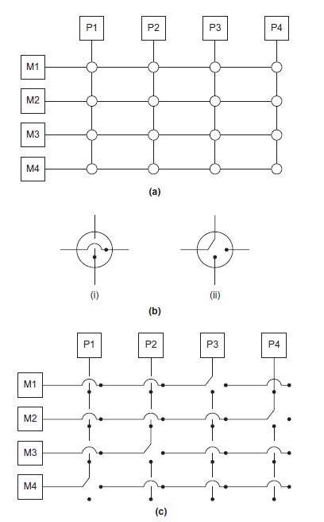
Figure 2.7
(a)
A crossbar switch connecting 4 processors (Pi) and 4 memory modules (Mj)
(b)
Configuration of internal switches in a crossbar
(c) Simultaneous memory accesses by the processors

Slide 78
Distributed memory interconnects
Two groups
Direct interconnect
Each switch is directly connected to a processor memory pair, and the switches are connected to each other.
Indirect interconnect
Switches may not be directly connected to a processor.

Slide 79
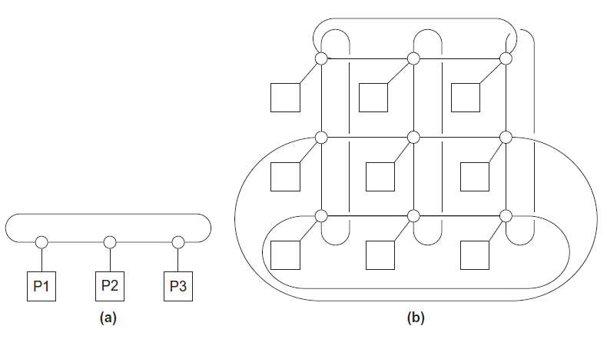
Direct interconnect
Figure 2.8
ring
toroidal mesh

Slide 80

Bisection width
A measure of “number of simultaneous communications” or “connectivity”.
How many simultaneous communications can take place “across the divide” between the halves?

Slide 81
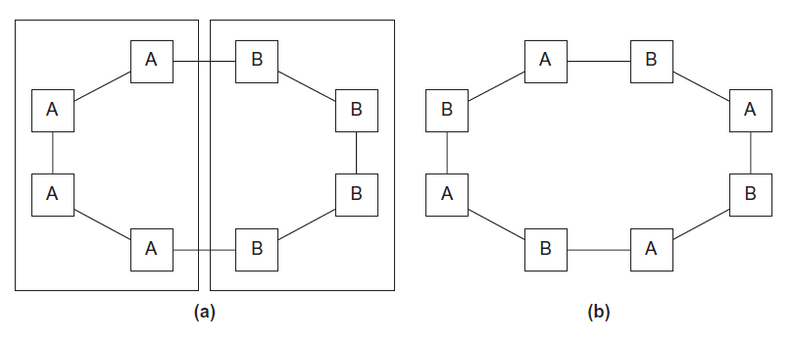
Two bisections of a ring
Figure 2.9

Slide 82
A bisection of a toroidal mesh
Figure 2.10

Slide 83
Definitions
Bandwidth
The rate at which a link can transmit data.
Usually given in megabits or megabytes per second.
Bisection bandwidth
A measure of network quality.
Instead of counting the number of links joining the halves, it sums the bandwidth of the links.

Slide 84
Fully connected network
Each switch is directly connected to every other switch.
impractical
bisection width = p²/4
Figure 2.11

Slide 85
Hypercube
Highly connected direct interconnect.
Built inductively:
A one-dimensional hypercube is a fully-connected system with two processors.
A two-dimensional hypercube is built from two one-dimensional hypercubes by joining “corresponding” switches.
Similarly a three-dimensional hypercube is built from two two-dimensional hypercubes.

Slide 86
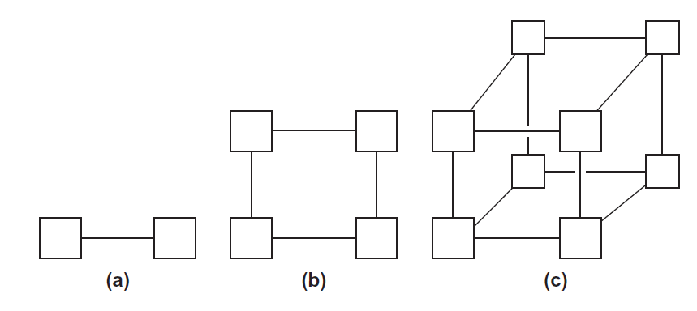
Hypercubes
Figure 2.12
one-
two-
three-dimensional

Slide 87
Indirect interconnects
Simple examples of indirect networks:
Crossbar
Omega network
Often shown with unidirectional links and a collection of processors, each of which has an outgoing and an incoming link, and a switching network.

Slide 88
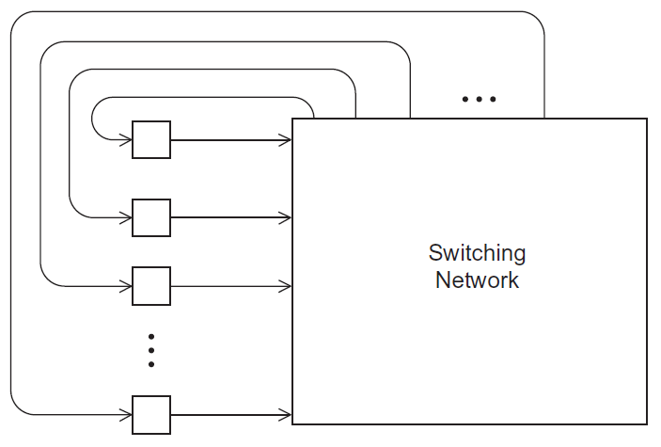
A generic indirect network
Figure 2.13

Slide 89
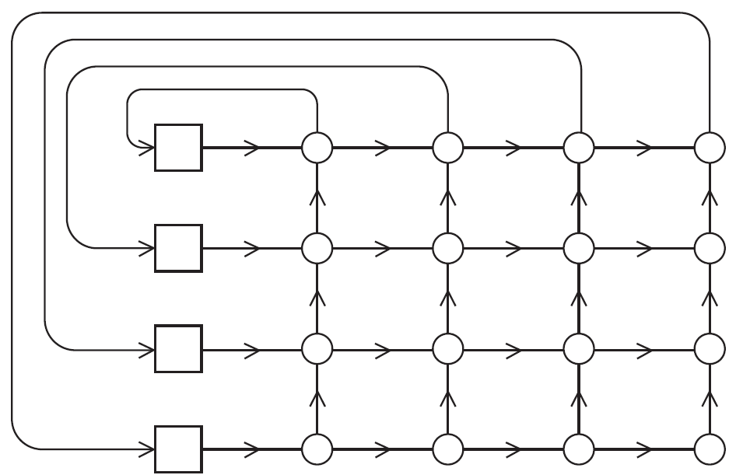
Crossbar interconnect for distributed memory
Figure 2.14

Slide 90
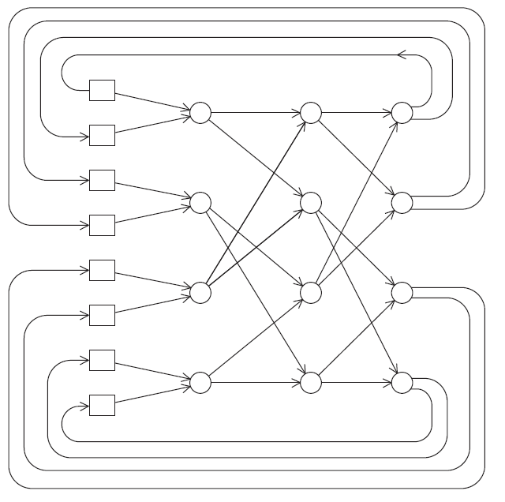
An omega network
Figure 2.15

Slide 91
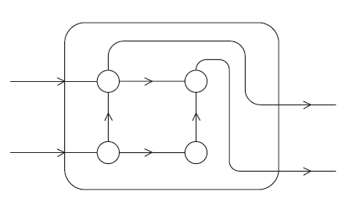
A switch in an omega network
Figure 2.16

Slide 92
More definitions
Any time data is transmitted, we’re interested in how long it will take for the data to reach its destination.
Latency
The time that elapses between the source’s beginning to transmit the data and the destination’s starting to receive the first byte.
Bandwidth
The rate at which the destination receives data after it has started to receive the first byte.

Slide 93
Message transmission time = l + n / b
latency (seconds)
length of message (bytes)
bandwidth (bytes per second)

Slide 94
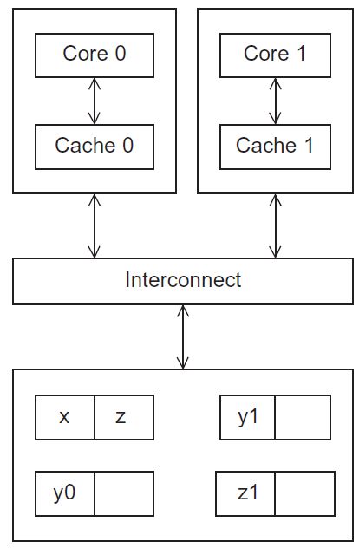
Cache coherence
Programmers have no control over caches and when they get updated.
Figure 2.17
A shared memory system with two cores and two caches

Slide 95
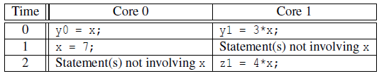
Cache coherence
y0 privately owned by Core 0
y1 and z1 privately owned by Core 1
x = 2; /* shared variable */
y0 eventually ends up = 2
y1 eventually ends up = 6
z1 = ???

Slide 96
Snooping Cache Coherence
The cores share a bus .
Any signal transmitted on the bus can be “seen” by all cores connected to the bus.
When core 0 updates the copy of x stored in its cache it also broadcasts this information across the bus.
If core 1 is “snooping” the bus, it will see that x has been updated and it can mark its copy of x as invalid.

Slide 97
Directory Based Cache Coherence
Uses a data structure called a directory that stores the status of each cache line.
When a variable is updated, the directory is consulted, and the cache controllers of the cores that have that variable’s cache line in their caches are invalidated.

Slide 98

Parallel software

Slide 99
The burden is on software
Hardware and compilers can keep up the pace needed.
From now on…
In shared memory programs:
Start a single process and fork threads.
Threads carry out tasks.
In distributed memory programs:
Start multiple processes.
Processes carry out tasks.

Slide 100

SPMD – single program multiple data
A SPMD programs consists of a single executable that can behave as if it were multiple different programs through the use of conditional branches.
if (I’m thread process i)
do this;
else
do that;

Slide 101
Writing Parallel Programs
double x[n], y[n];
…
for (i = 0; i < n; i++)
x[i] += y[i];
Divide the work among the processes/threads
so each process/thread gets roughly the same amount of work
and communication is minimized.
Arrange for the processes/threads to synchronize.
Arrange for communication among processes/threads.

Slide 102
Shared Memory
Dynamic threads
Master thread waits for work, forks new threads, and when threads are done, they terminate
Efficient use of resources, but thread creation and termination is time consuming.
Static threads
Pool of threads created and are allocated work, but do not terminate until cleanup.
Better performance, but potential waste of system resources.

Slide 103

Nondeterminism
. . .
printf ( "Thread %d > my_val = %d\n" , my_rank , my_x ) ;
. . .
Thread 0 > my_val = 7
Thread 1 > my_val = 19
Thread 1 > my_val = 19
Thread 0 > my_val = 7

Slide 104
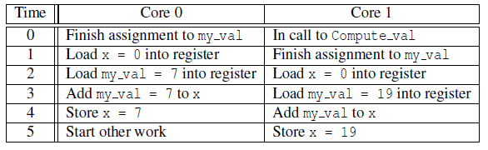
Nondeterminism
my_val = Compute_val ( my_rank ) ;
x += my_val ;

Slide 105
Nondeterminism
Race condition
Critical section
Mutually exclusive
Mutual exclusion lock (mutex, or simply lock)
my_val = Compute_val ( my_rank ) ;
Lock(&add_my_val_lock ) ;
x += my_val ;
Unlock(&add_my_val_lock ) ;

Slide 106
busy-waiting
my_val = Compute_val ( my_rank ) ;
i f ( my_rank == 1)
whi l e ( ! ok_for_1 ) ; /* Busy−wait loop */
x += my_val ; /* Critical section */
i f ( my_rank == 0)
ok_for_1 = true ; /* Let thread 1 update x */

Slide 107
message-passing
char message [ 1 0 0 ] ;
. . .
my_rank = Get_rank ( ) ;
i f ( my_rank == 1) {
sprintf ( message , "Greetings from process 1" ) ;
Send ( message , MSG_CHAR , 100 , 0 ) ;
} e l s e i f ( my_rank == 0) {
Receive ( message , MSG_CHAR , 100 , 1 ) ;
printf ( "Process 0 > Received: %s\n" , message ) ;
}

Slide 108
Partitioned Global Address Space Languages
shared i n t n = . . . ;
shared double x [ n ] , y [ n ] ;
private i n t i , my_first_element , my_last_element ;
my_first_element = . . . ;
my_last_element = . . . ;
/ * Initialize x and y */
. . .
f o r ( i = my_first_element ; i <= my_last_element ; i++)
x [ i ] += y [ i ] ;

Slide 109
Input and Output
In distributed memory programs, only process 0 will access stdin. In shared memory programs, only the master thread or thread 0 will access stdin.
In both distributed memory and shared memory programs all the processes/threads can access stdout and stderr.

Slide 110
Input and Output
However, because of the indeterminacy of the order of output to stdout, in most cases only a single process/thread will be used for all output to stdout other than debugging output.
Debug output should always include the rank or id of the process/thread that’s generating the output.

Slide 111
Input and Output
Only a single process/thread will attempt to access any single file other than stdin, stdout, or stderr. So, for example, each process/thread can open its own, private file for reading or writing, but no two processes/threads will open the same file.

Slide 112

Performance

Slide 113

Speedup
Number of cores = p
Serial run-time = T_{serial}
Parallel run-time = T_{parallel}
linear speedup
T_{parallel} = T_{serial} / p

Slide 114
Speedup of a parallel program
T_{serial}
S =
T_{parallel}

Slide 115
Efficiency of a parallel program
T_{serial}
T_{parallel}
S
T_{serial}
E =
=
=
.
p
p
p T_{parallel}

Slide 116

Speedups and efficiencies of a parallel program

Slide 117
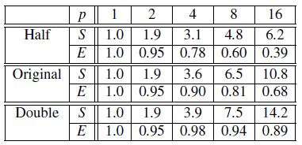
Speedups and efficiencies of parallel program on different problem sizes

Slide 118
Speedup

Slide 119
Efficiency

Slide 120
Effect of overhead
T_{parallel} = T_{serial} / p + T_{overhead}

Slide 121

Amdahl’s Law
Unless virtually all of a serial program is parallelized, the possible speedup is going to be very limited — regardless of the number of cores available.

Slide 122
Example
We can parallelize 90% of a serial program.
Parallelization is “perfect” regardless of the number of cores p we use.
T_{serial} = 20 seconds
Runtime of parallelizable part is
0.9 x T_{serial} / p = 18 / p

Slide 123
Example (cont.)
Runtime of “unparallelizable” part is
Overall parallel run-time is
0.1 x T_{serial} = 2
T_{parallel} = 0.9 x T_{serial} / p + 0.1 x T_{serial} = 18 / p + 2

Slide 124
Example (cont.)
Speed up
T_{serial}
20
S =
=
0.9 x T_{serial} / p + 0.1 x T_{serial}
18 / p + 2

Slide 125
Scalability
In general, a problem is scalable if it can handle ever increasing problem sizes.
If we increase the number of processes/threads and keep the efficiency fixed without increasing problem size, the problem is strongly scalable.
If we keep the efficiency fixed by increasing the problem size at the same rate as we increase the number of processes/threads, the problem is weakly scalable.

Slide 126

Taking Timings
What is time?
Start to finish?
A program segment of interest?
CPU time?
Wall clock time?

Slide 127
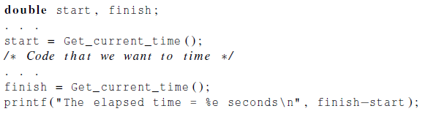
Taking Timings
theoretical
function
omp_get_wtime
MPI_Wtime

Slide 128
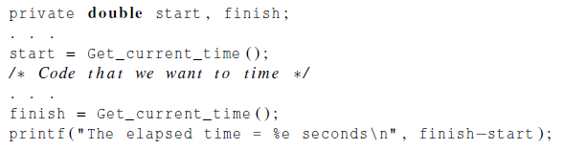
Taking Timings

Slide 129
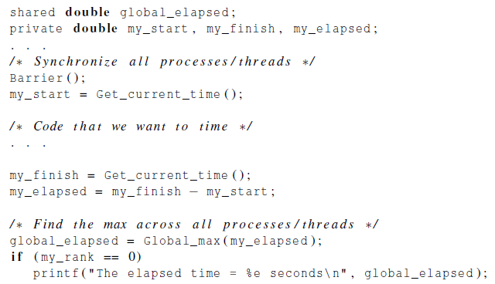
Taking Timings

Slide 130
Parallel program design

Slide 131
Foster’s methodology
Partitioning: divide the computation to be performed and the data operated on by the computation into small tasks. The focus here should be on identifying tasks that can be executed in parallel.

Slide 132

Foster’s methodology
Communication: determine what communication needs to be carried out among the tasks identified in the previous step.

Slide 133
Foster’s methodology
Agglomeration or aggregation: combine tasks and communications identified in the first step into larger tasks. For example, if task A must be executed before task B can be executed, it may make sense to aggregate them into a single composite task.

Slide 134
Foster’s methodology
Mapping: assign the composite tasks identified in the previous step to processes/threads. This should be done so that communication is minimized, and each process/thread gets roughly the same amount of work.

Slide 135
Example - histogram
1.3,2.9,0.4,0.3,1.3,4.4,1.7,0.4,3.2,0.3,4.9,2.4,3.1,4.4,3.9,0.4,4.2,4.5,4.9,0.9

Slide 136
Serial program - input
The number of measurements: data_count
An array of data_count floats: data
The minimum value for the bin containing the smallest values: min_meas
The maximum value for the bin containing the largest values: max_meas
The number of bins: bin_count

Slide 137
Serial program - output
bin_maxes : an array of bin_count floats
bin_counts : an array of bin_count ints

Slide 138
First two stages of Foster’s Methodology

Slide 139
Alternative definition of tasks and communication

Slide 140
Adding the local arrays

Slide 141
Concluding Remarks (1)
Serial systems
The standard model of computer hardware has been the von Neumann architecture.
Parallel hardware
Flynn’s taxonomy.
Parallel software
We focus on software for homogeneous MIMD systems, consisting of a single program that obtains parallelism by branching.
SPMD programs.

Slide 142
Concluding Remarks (2)
Input and Output
We’ll write programs in which one process or thread can access stdin, and all processes can access stdout and stderr.
However, because of nondeterminism, except for debug output we’ll usually have a single process or thread accessing stdout.

Slide 143
Concluding Remarks (3)
Performance
Speedup
Efficiency
Amdahl’s law
Scalability
Parallel Program Design
Foster’s methodology

